Slide 1

RIS Activity @ Tejas
Jishnu Aravindakshan
March 2025

Slide 2
RIS activity at Tejas
Studying Controlled passive RIS (CPRIS) for outdoor scenario
Working closely with academia to build next generation of CPRIS
Understanding various type of CPRIS
Theoretical modelling of CPRIS for outdoor scenario
Joint testing of CPRIS in lab and field
Validating the simulation model for CPRIS
Conducting measurements in lab to understand RF level issues.
Researching next generation of RIS.
Working with TSDSI (3GPP ?) for RIS standardization

Slide 3
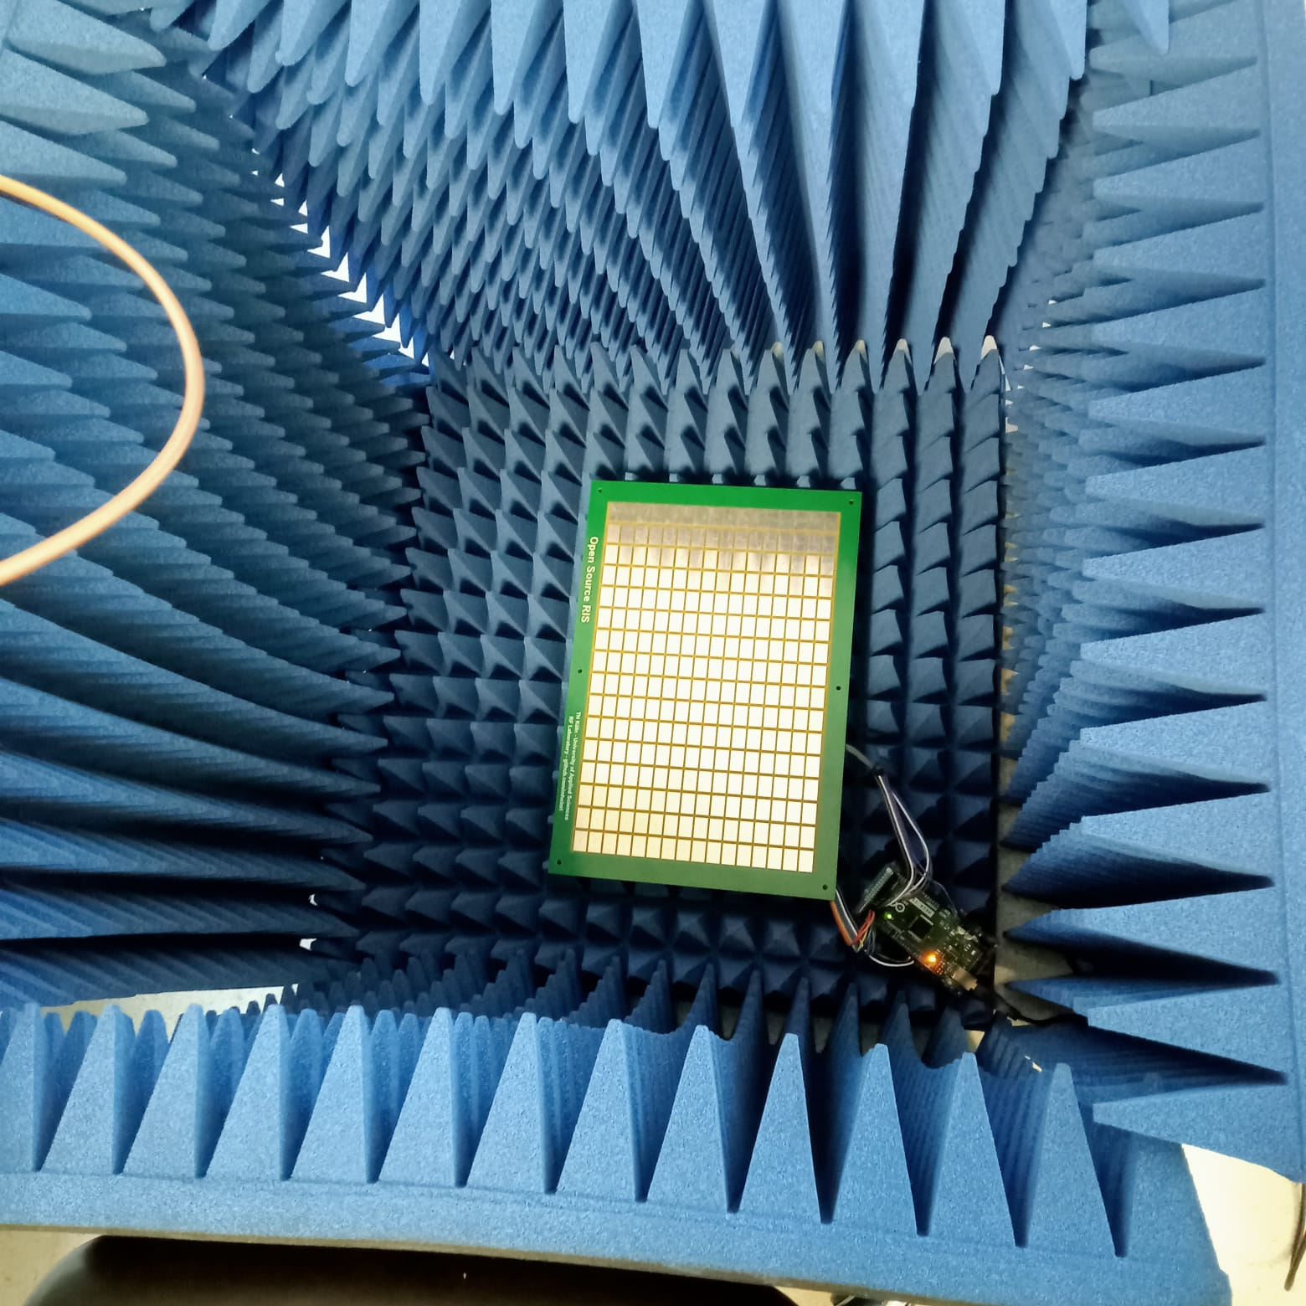
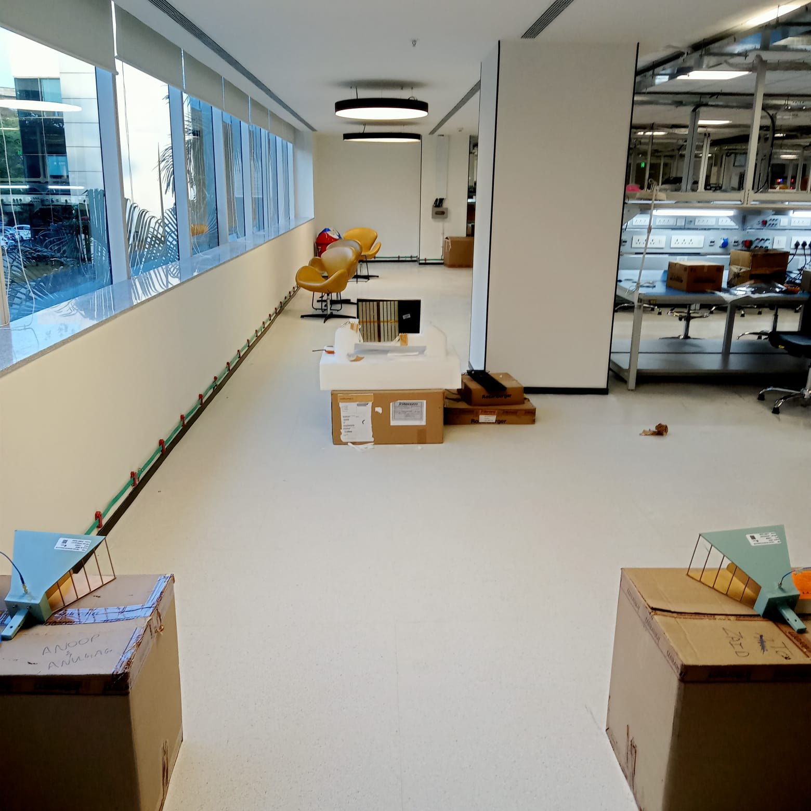
RIS lab measurements
S11 measurements
S21 measurements

Slide 4
Email id here
Contact Number here

